Slide 1
ICP 2019 Datathon
Ian Piper
Scotland

Slide 2
Overview
2nd Datathon with the BrainIT datasets
BrainIT 1: 2002-2006
261 TBI patients, 22 EU Centres
2 x 10⁶ monitoring data samples
BrainIT 2: 2010-2012
67 TBI patients (6 EU Centres).

Slide 3
Overview
Datathon Glasgow 2017
Comprised entirely of Data Scientists interested in access to Clinical Data
Datathon Leuven 2019
Comprised mostly Clinicians interested in learning more about data science

Slide 4
Steps
Define the Research Question
Understanding the Dataset
Feature Selection
Model Selection/Training/Testing
Model Assessment (KPI)

Slide 5
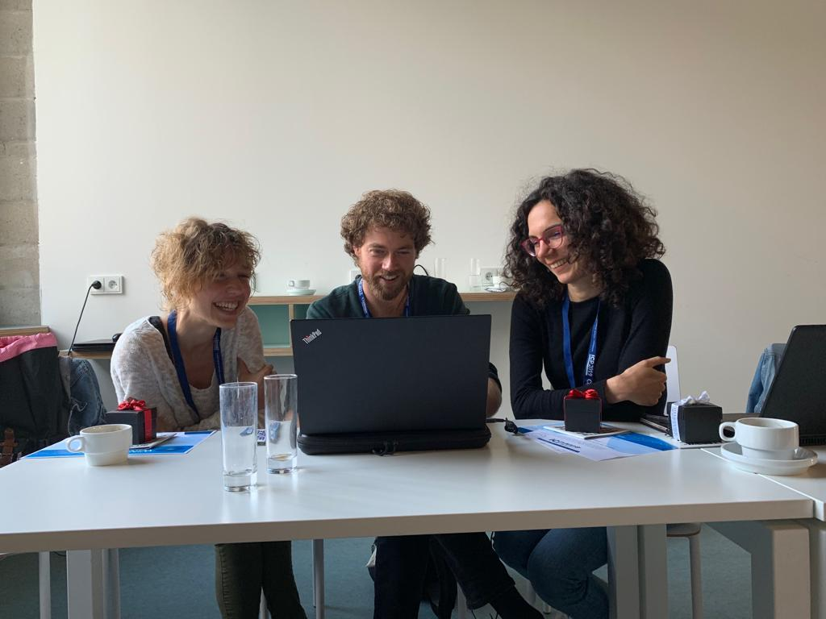
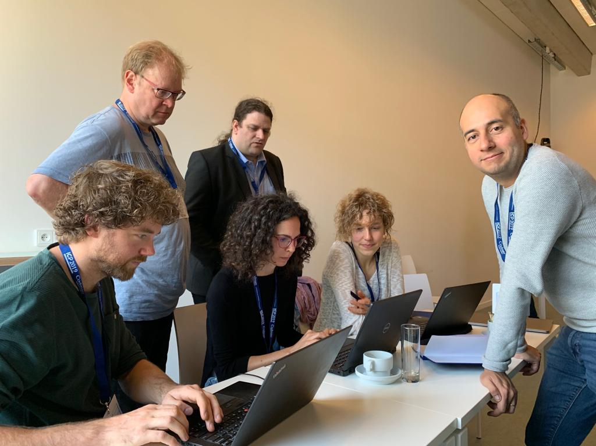
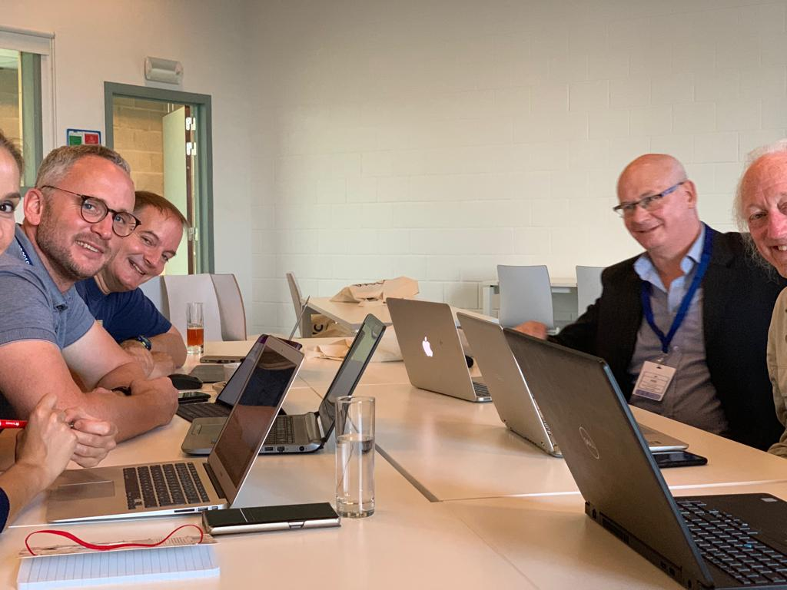
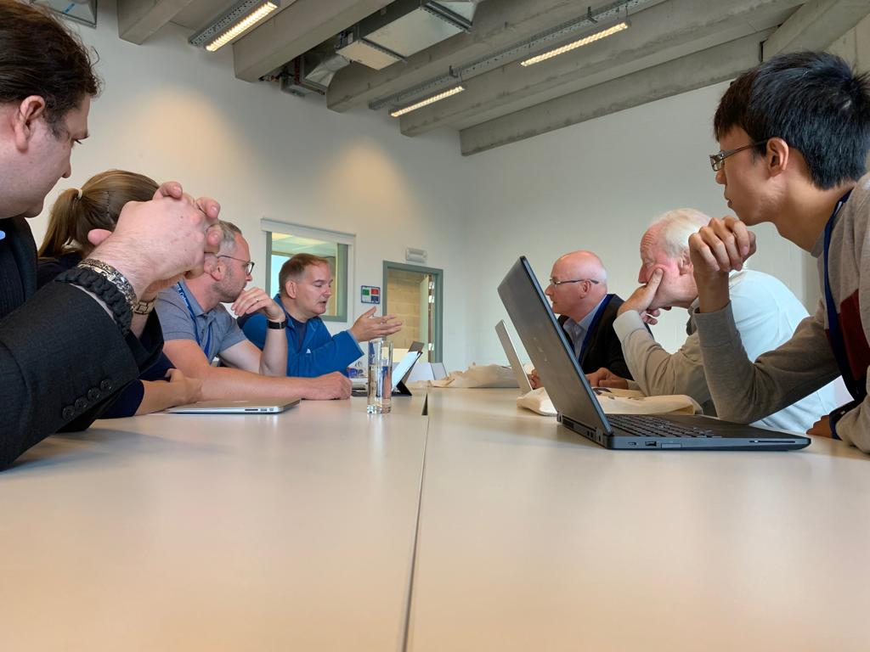
Group Formation?

Slide 6
ICP Secondary Insult Definition
ICP
Raised ICP Threshold x 2 (20 & 30 mmHg)
+- 2 mins
A
B
C
ICP minimum Event Duration = 5 & 30 mins – For Both Start and End of Event
Time →

Slide 7
Resources
Two mixed teams of staticians, data scientists, engineers and clinicians
BrainIT database: 261 TBI patients, 7825 hours of minute by minute data
8 hours
Advice & Support

Slide 8
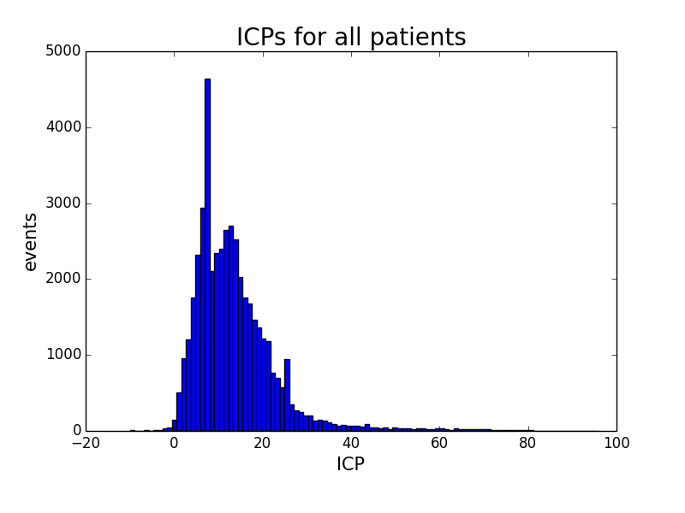

Slide 9
Event definition
ICP > 20 mmHg lasting > 5 minutes

Slide 10
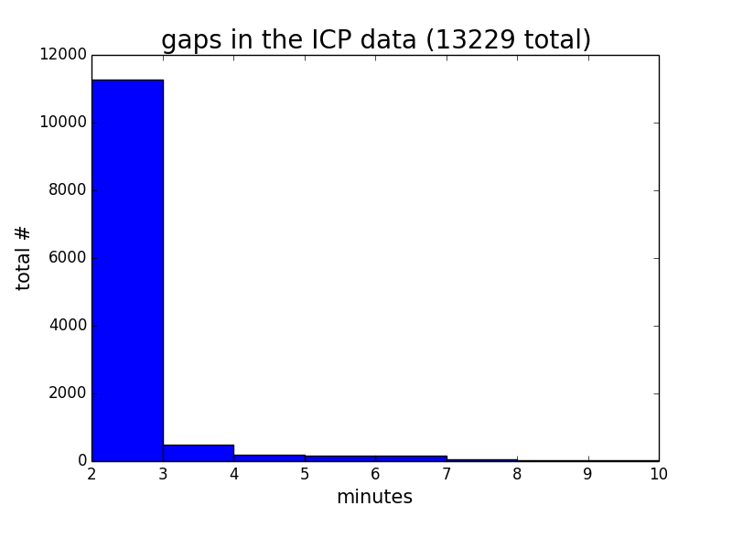

Slide 11
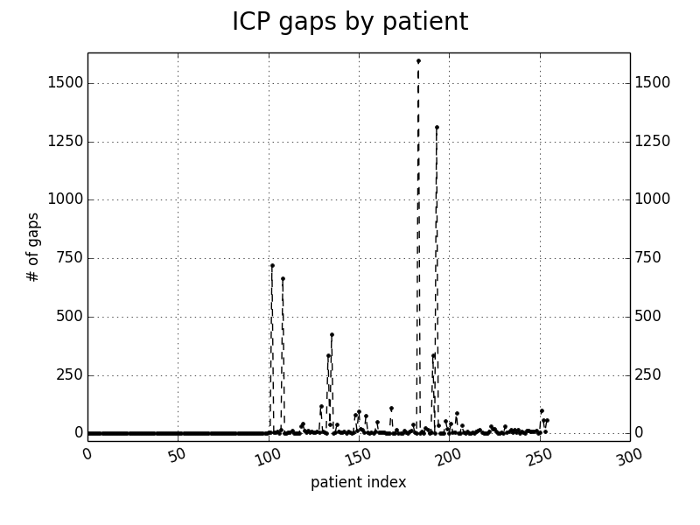
Results?

Slide 12
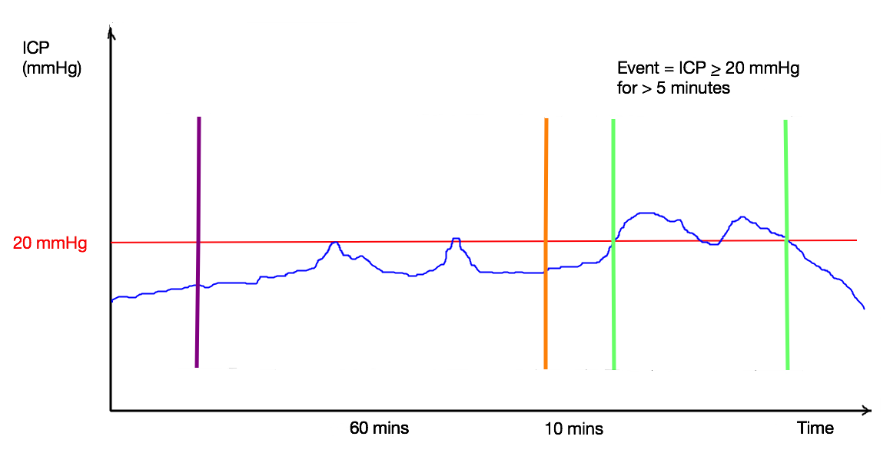
Event definition
prediction
data window
event

Slide 13
Event identification algorhitm
event
ICP | 12 | 14 | 16 | 23 | 19 | 23 | 24 | 22 | 28 | 21 | 24 | 23 | 18 | 21 | 21 | 19 | 16 | 14 | 18 | 19
EVENT
Event start – 5 ICP values > 20 mmHg
Event end – 5 ICP values ≤ 20 mmHg
Random Forest machine learning model

Slide 14
Predictive model features
ICP median
ICP sd (slow changes)
ICP rmssd (rapid changes)
ICP linear regression slope
number of ICP > 20 mmHg values
ICP last value
MAP sd
CPP dose <60 mmHg (mmHg.min⁻¹)
CPP dose > 90 mmHg (mmHg.min⁻¹)
LAx dose > 0.3 (min⁻¹)

Slide 15
Event identification algorhitm
event
ICP | 12 | 14 | 16 | 23 | 19 | 23 | 24 | 22 | 28 | 21 | 24 | 23 | 18 | 21 | 21 | 19 | 16 | 14 | 18 | 19
EVENT
Event start – 5 ICP values > 20 mmHg
Event end – 5 ICP values ≤ 20 mmHg
Random Forest machine learning model, 11 patients
AUROC 0.91 (?)

Slide 16
Event identification algorhitm
event
event
ICP | 12 | 14 | 16 | 23 | 19 | 23 | 24 | 22 | 28 | 21 | 24 | 23 | 18 | 21 | 21 | 19 | 16 | 14 | 18 | 19
EVENT
event
Event start – 5 ICP values > 20 mmHg
Event end – 5 ICP values ≤ 20 mmHg
Random Forest machine learning model, 11 patients
AUROC 0.91 (?)

Slide 17
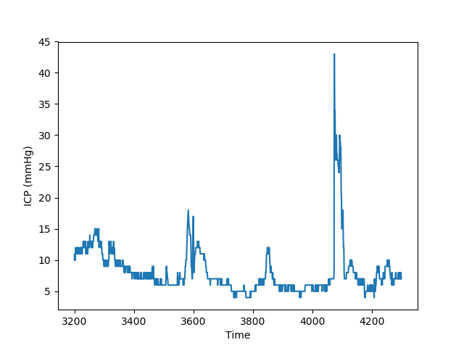
Results – Hair Group
Features:
ABP (mean, SD)
ICP (mean, SD)
Simple PRx
ETCO2
# ICP↑ events in past 3h
Demographics
CT characteristics
GCS
Etc.
Support Vector Machine
True Positive Rate = 0.9744
False Positive Rate = 0.2857
Data window
2 hours
Prediction horizon
30 min
ICP↑
event

Slide 18
Lessons learned
not easy but feasible..
80% of time and effort is spent on data pre-processing..
collaboration and cross-talk between clinical and „technical“ part of the team is a key to success..

Slide 19
Group Comments
“Access/Working with to a Large Dataset Exciting”
“Interesting to see process of data cleaning to machine learning”
“Surprised at how long it took to prepare the data”
“Need for more preparatory information about the datathon process”

Slide 20
Future of Datathon’s
Maybe we should run a regular BrainIT datathon?
As an introduction to “Hands-On” Data Science for Clinicians?
Maybe as a Means of Attracting Data Science people to our Meetings?

