Slide 1
Paediatric Brain Monitoring with Information Technology
(KidsBrainIT)
Dr. T.Y.M. Lo & Dr Ian Piper
Consultant Paediatric Intensivist
NHS Research Scotland Career Research Fellow
Royal Hospital for Sick Children
Edinburgh
&
Principal Health Care Scientist, BrainIT Group Coordinator
Usher Institute of Informatics/Population Health
&
Quality Improvement Coordinator
Royal Hospital for Sick Children
Edinburgh

Slide 2
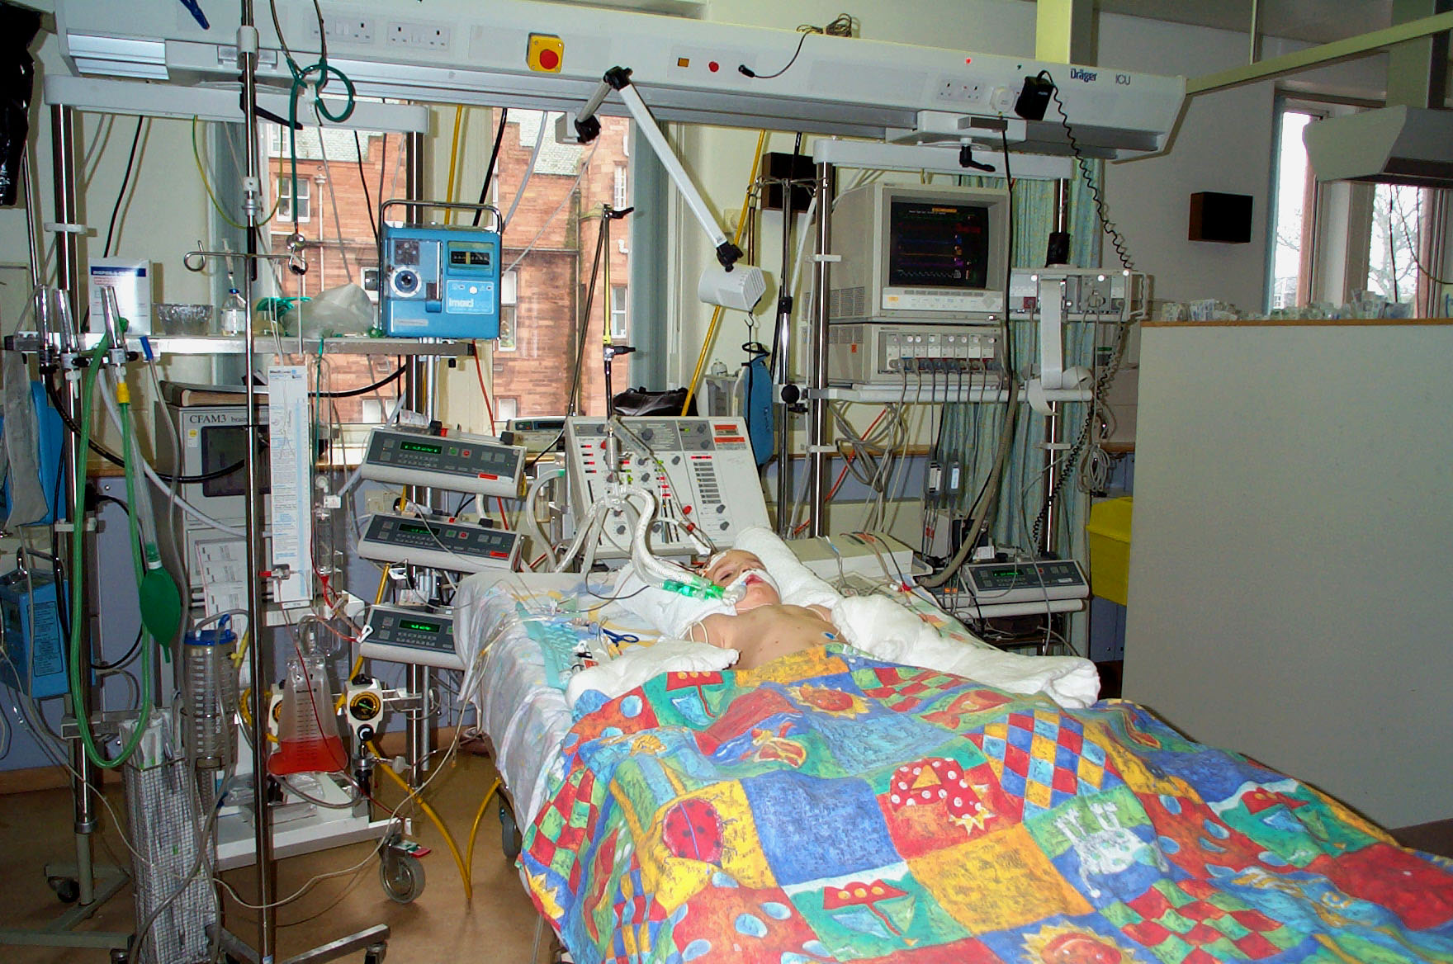
Paediatric Neuro-critical Care Best Rx Option -
Prevention of secondary physiological insults
Paediatric Guidelines. PCCM.

Slide 3
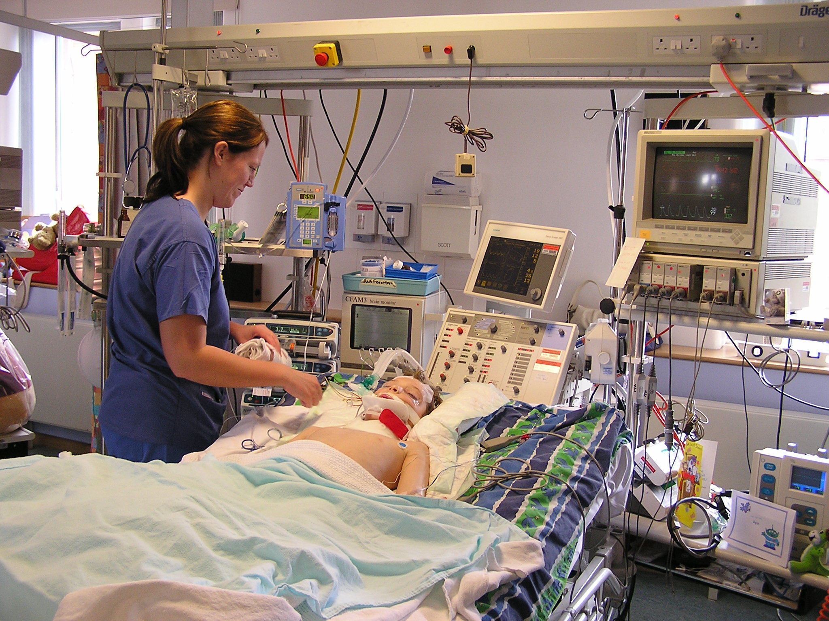
Routine Physiological Monitoring
Clinical use in PICU
At least minute resolution
Net-worked or non-networked monitors

Slide 4
Physiological Data
Beyond Clinical Care
Audit & Research
Variable and unit dependent
  High resolution data (at least minute resolution)
  Lower resolution data (5 minutely resolution)
  Low resolution data (e.g. end-hour recording)
Data archive & Storage
High resolution data is lost unless downloaded within a specific time frame (usually within 1 month for networked monitor)

Slide 5
BrainIT
Brain Monitoring with Information Technology (BrainIT)
Adult brain trauma collaboration
22 ICU across UK + Europe (11 countries)
Established in 1997
MDT collaborations
Using routinely collected physiological data (at least minutely resolution) to improve the intensive care management and outcome of brain injured adults.
Hypotheses testing, data analytics, research infrastructure
Openess & free collaboration (NOT competition)

Slide 6
Developing and Testing new Models?

Slide 7
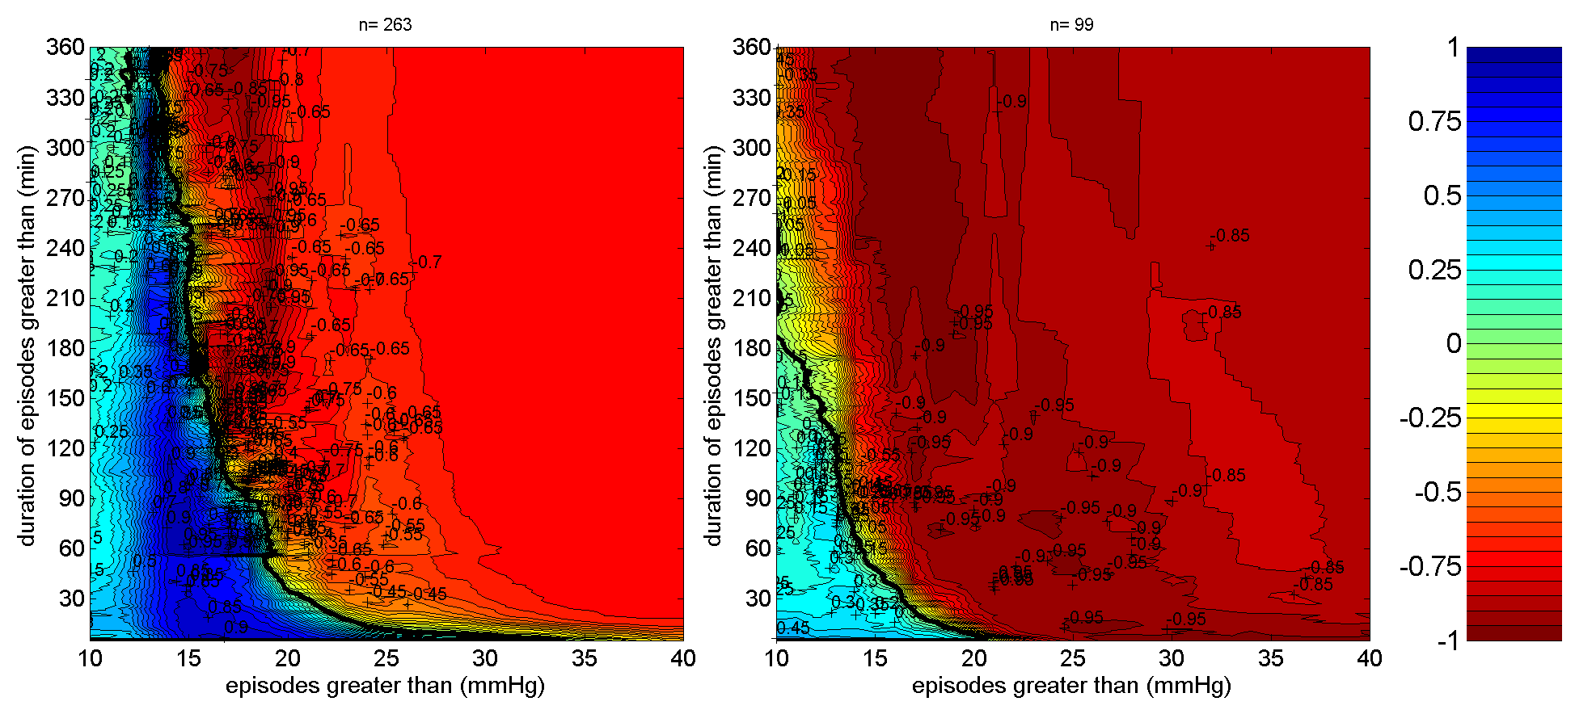

Slide 8
Paediatric BrainIT
Lagging behind compared to adult setting
No Paediatric equivalent of BrainIT
UK Paediatric data contribution to BrainIT
  Edinburgh-Newcastle 3 yrs (2000 – 2003)
  Edinburgh 3 yrs (2004 – 2007)
Compelling need to set up KidsBrainIT

Slide 9

A New Multi-centre, Multi-disciplinary, Multi-national Data Informatics Paediatric Brain Trauma Research Initiative
Notes:
Using the pilot data from Edinburgh-Newcastle-BrainIT collaboration, we applied for funding to set up KidsBrainIT.

Slide 10
KidsBrainIT - Timeline
KidsBrainIT launch, BrainIT meeting, Barcelona, Oct 2015
Infrastructure development funding Sept 2016
  Neuroscience Foundation (£11,220)
Phase 1 funding secured Nov 2016
  EU grant (ERA-NET NEURON)
    621,843 Euros over 2 years
  15 PICU in 5 countries (10 UK, 1 Belgium, 1 Spain, 2 Romania, 1 Latvia)
Phase 1 data collection starts (Nov 2017)
Notes:
94 proposals were submitted to ERA-NET NEURON ‘External Insults to the Nervous System’ call, of which 19 proposed projects were funded. We are the only one paediatric TBI consortium of the 19 funded projects.

Slide 11
KidsBrainIT Phase 1
To recruit 146 patients (2 – 16 years old)
Data-bank – Current + Future Research Use
2 hypotheses:
  Patients with measured CPP within CPPopt have (1) improved outcome & (2) better ICP tolerance
    CPPopt – LAx-CPP plots; ICP dose-response visualisation plots
Novel technology development sub-study (Barcelona + Edinburgh)
    Non-invasive continuous cerebral blood flow and metabolism monitoring (Hybrid diffuse optical technology)

Slide 12
Cerebral Perfusion Pressure
(CPP)
CPP = MAP – ICP
Proxy measurement of brain perfusion
Optimal CPP relates to having intact
cerebral-autoregulation

Slide 13
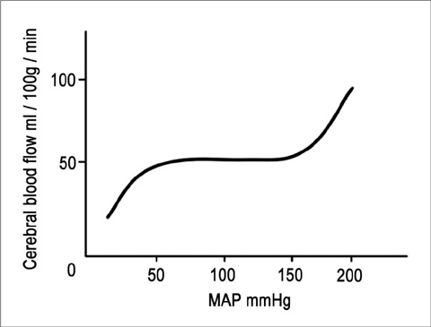
Historical Concepts

Slide 14
Historical Concepts

Slide 15
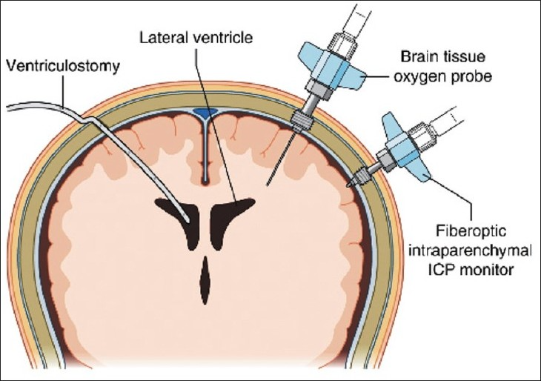

Slide 16
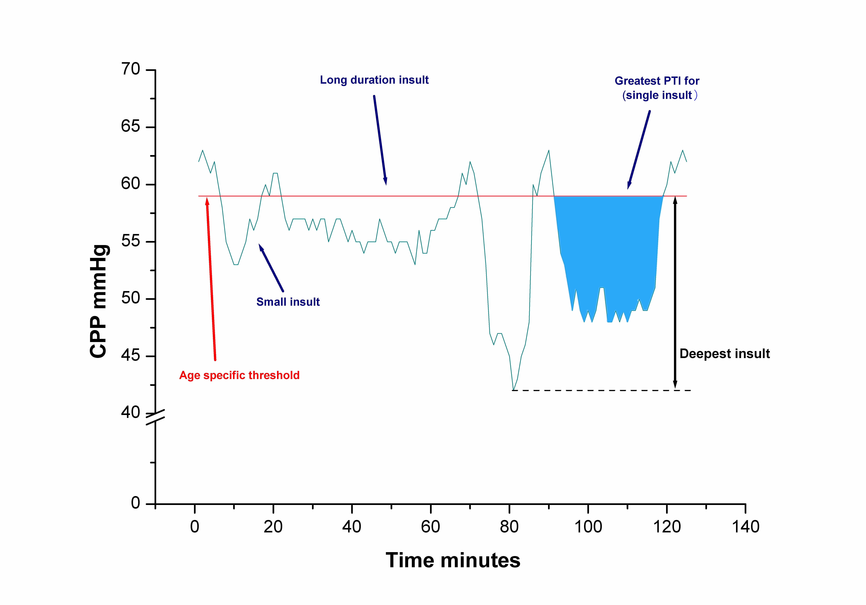
All individual characteristics of CPP
affect brain trauma outcome
Lo et al, PCCM 2011 (Suppl)

Slide 17
Pressure Active vs
Pressure Passive patterns
Optimal CPP relates to cerebral autoregulation
Ability to maintain stable ICP for varying MAP
(pressure active pattern)
Pressure Active
ICP varies inversely with MAP
Pressure Passive
ICP varies together with MAP
MAP
MAP
MAP
ICP
ICP

Slide 18
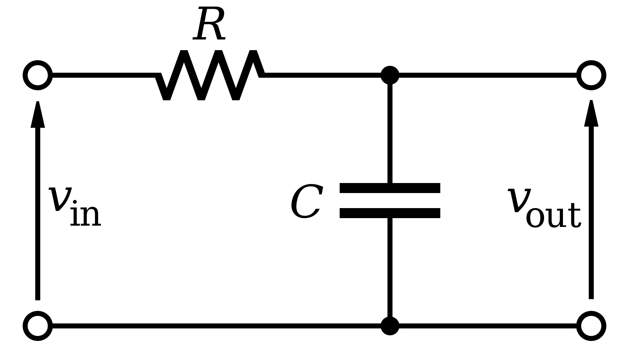
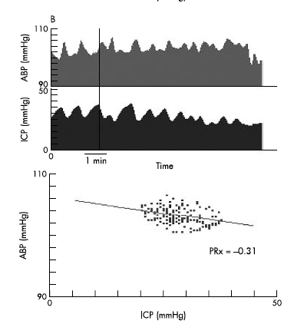
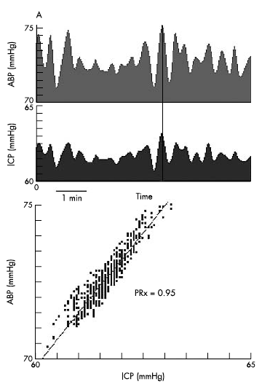
Historical Concepts
BP
ICP

Slide 19
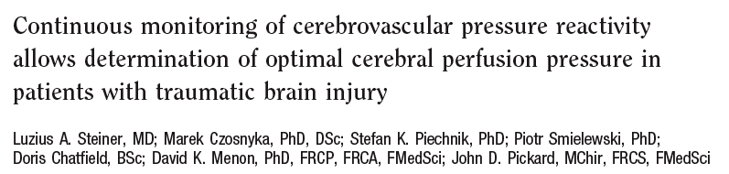
Historical Concepts

Slide 20
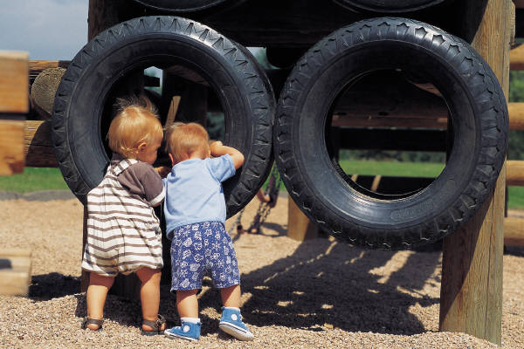
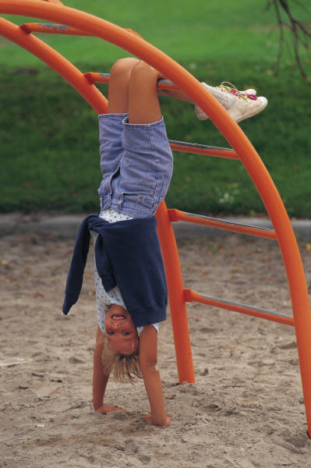

Critical Age-related
CPP Insult Thresholds
Aged 2 - 6 yrs - 48 mmHg
Aged 7 - 10 yrs - 54 mmHg
Age 11 - 16 yrs - 56 mmHg
(Chambers, Jones, Lo et al JNNP 2006)

Slide 21
Age-related CPP Thresholds
(Evidence Based)
Aged
2 – 6 yrs
Aged
7 – 10 yrs
Aged
11 – 16 yrs
Optimal
CPP
Thresholds
?
?
?
Critical
Insult
Thresholds
48 mmHg
54 mmHg
58 mmHg
Chambers, Jones, Lo et al. JNNP 2006

Slide 22
KidsBrainIT Phase 1
UK
10 PICU – Edinburgh, Glasgow, Newcastle, Birmingham, Liverpool, Oxford, Nottingham, Manchester, Bristol, London
EU
5 centres – Leuven (Belgium); Barcelona (Spain); Riga (Latvia) Iasi (Romania), Bucharest (Romania)
New centres signing on: Germany, Spain

Slide 23
TBI Patient admitted to PICU
(1) Delayed consenting model
(2) Complete electronic CRF on Java Tool
Unique study identifier is generated by Java Tool
(Fully anonymised data, no patient identifiable details,
Java Tool is pre-loaded in KidsBrainIT laptop)
(3) Extract Physiological data from monitoring system
Java Tool will strap patient identifiers and date & time stamps
(4) Anonymised clinical & physiological data sent to KidsBrainIT Data bank
(5) Telephone outcome questionaire at 6 & 12 months post-injury
Anonymised outcome data sent to KidsBrainIT Data Bank

Slide 24
Clinical Data Collection?

Slide 25
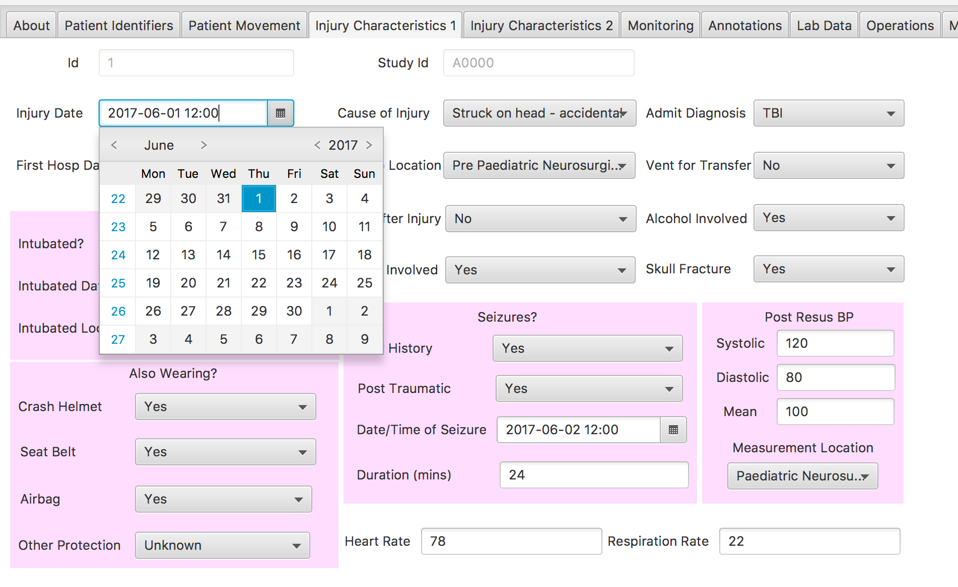
Old JAVA Tool System

Slide 26
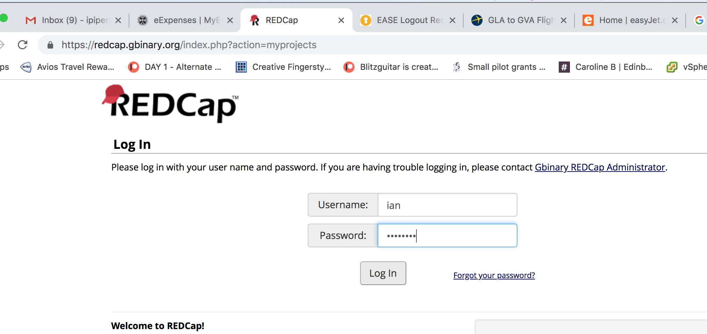
New RedCap System

Slide 27
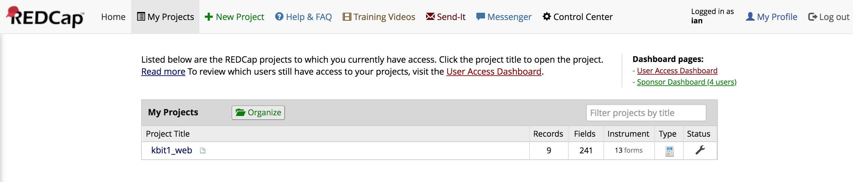
RedCap System

Slide 28
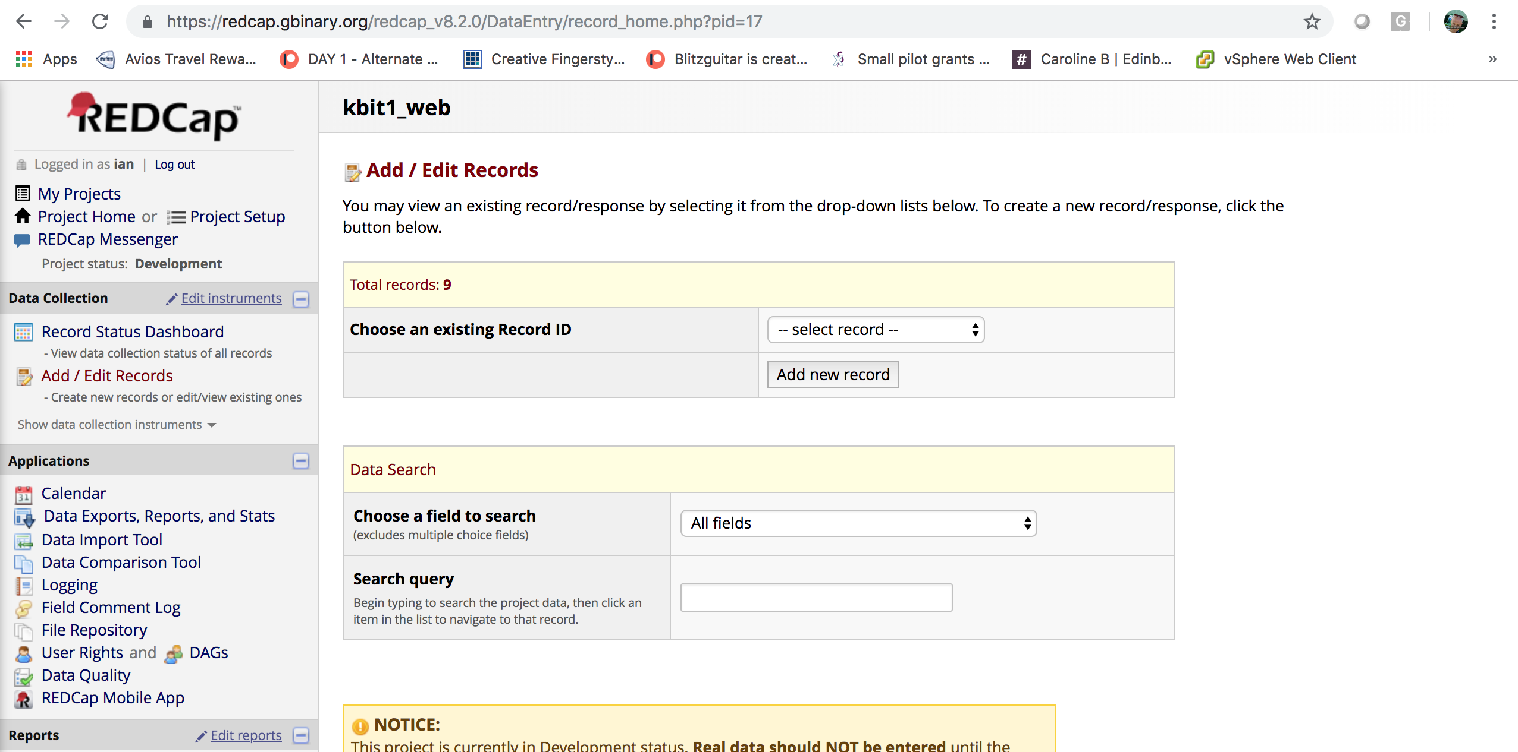
RedCap System

Slide 29
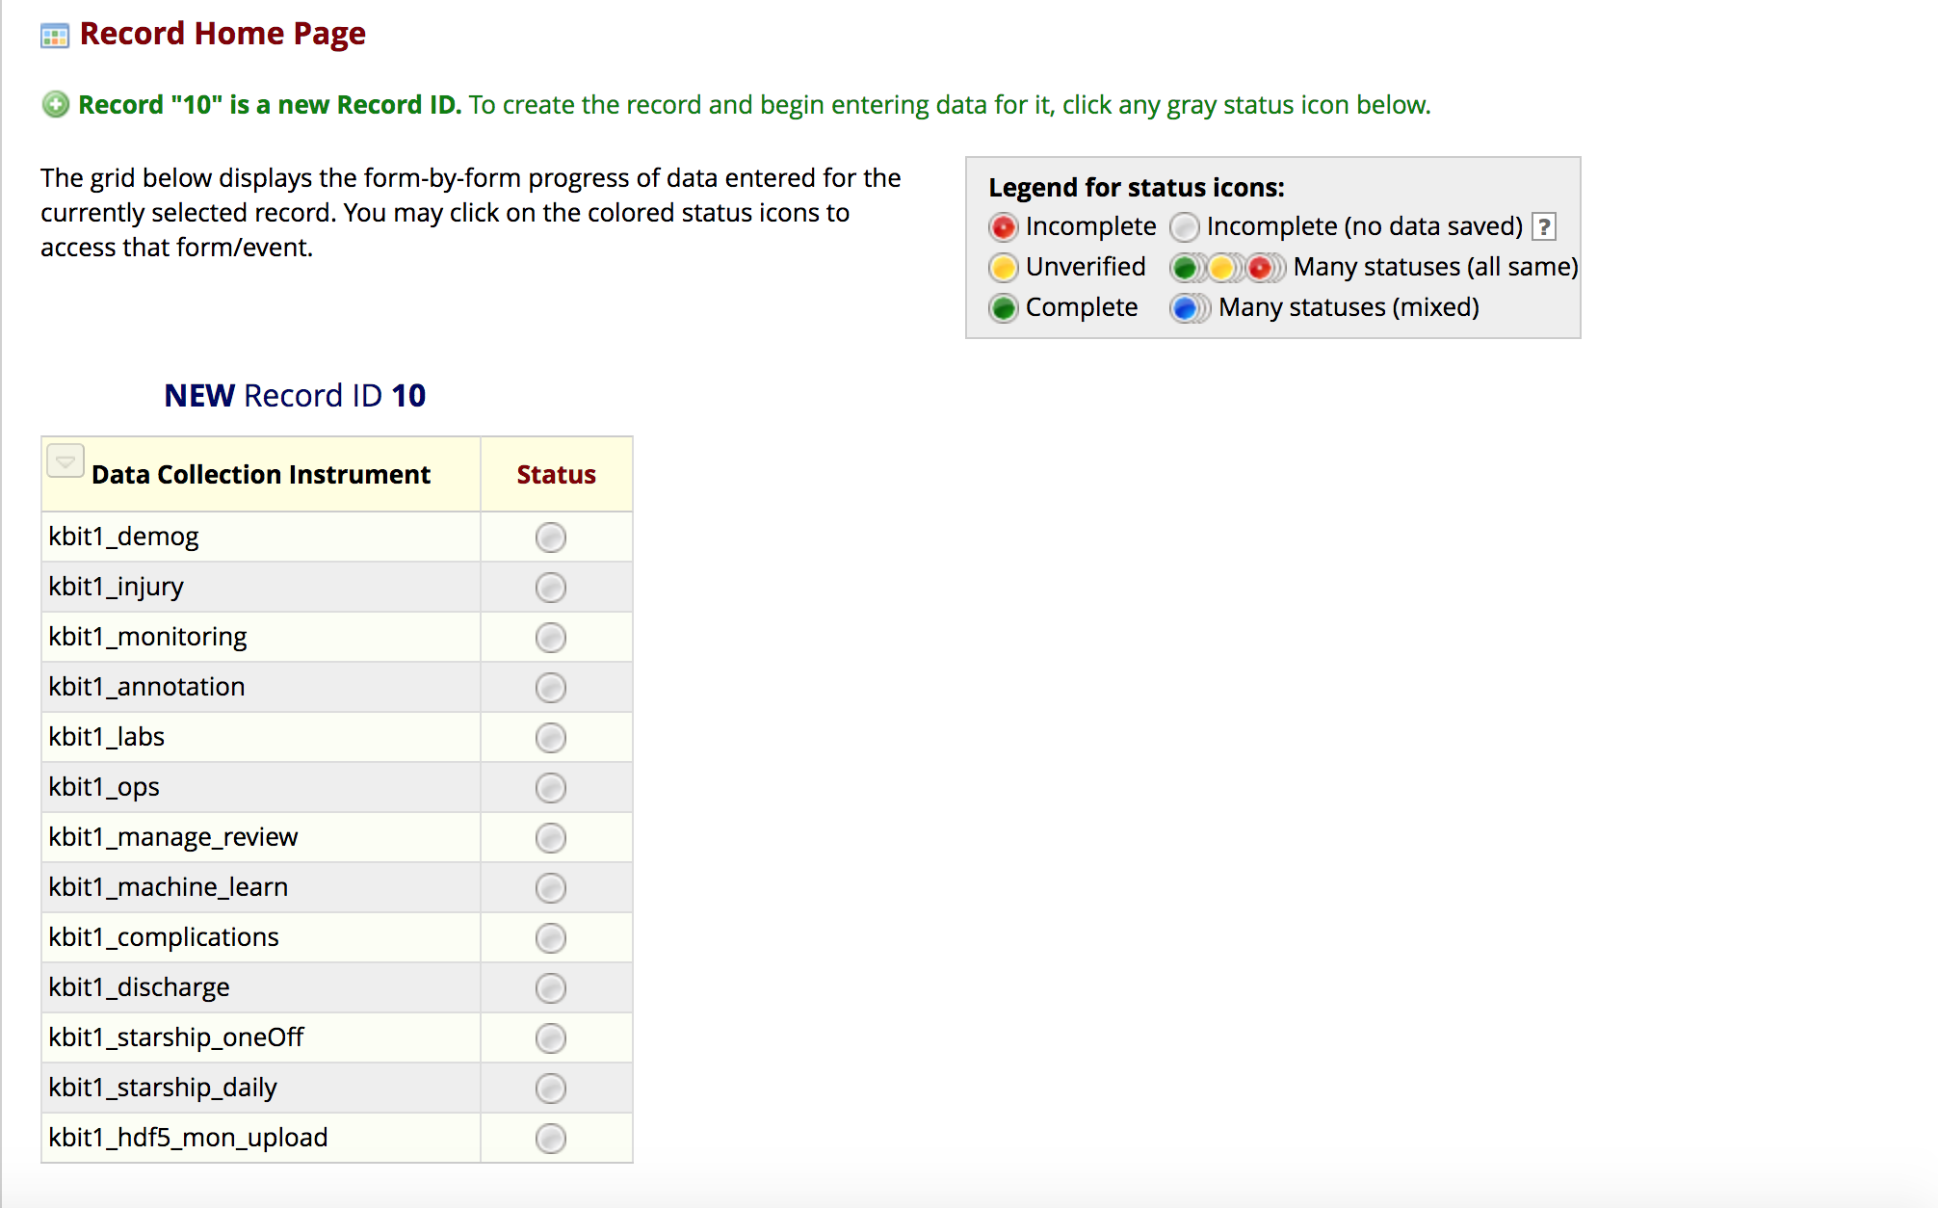
RedCap System

Slide 30
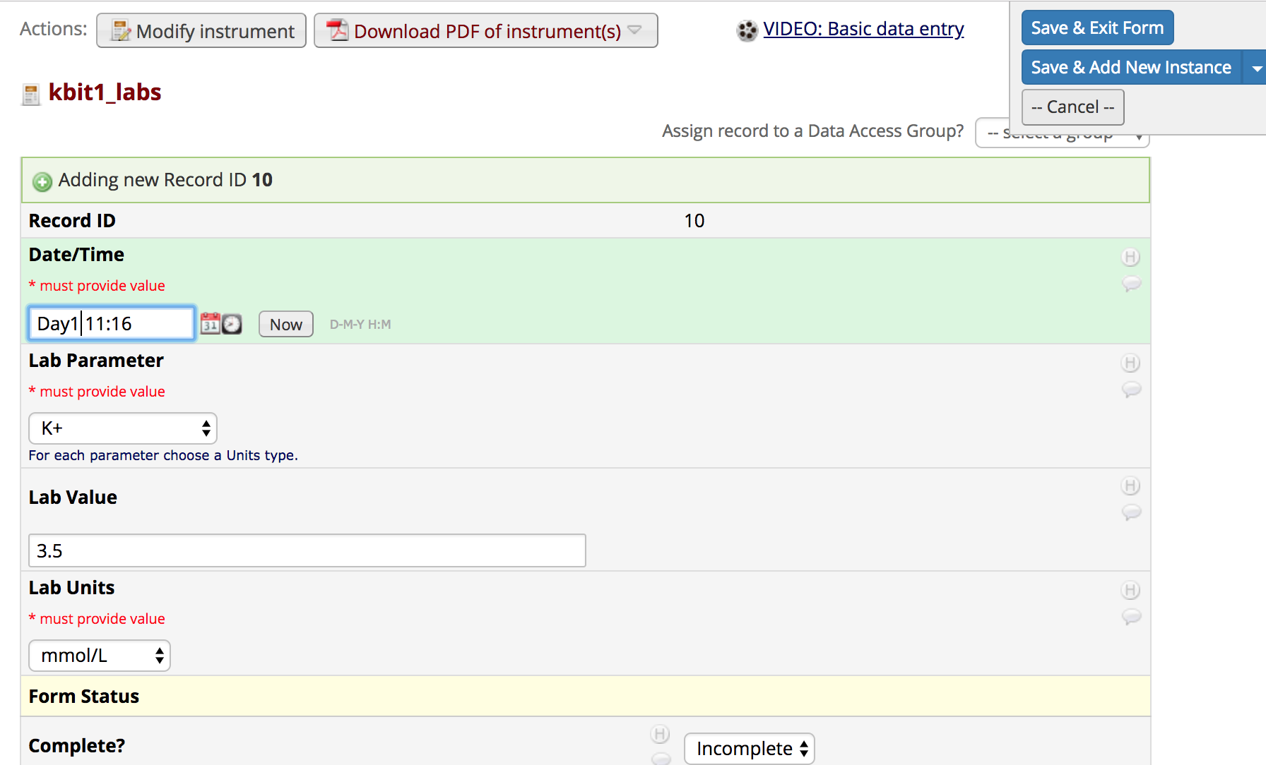
RedCap System

Slide 31
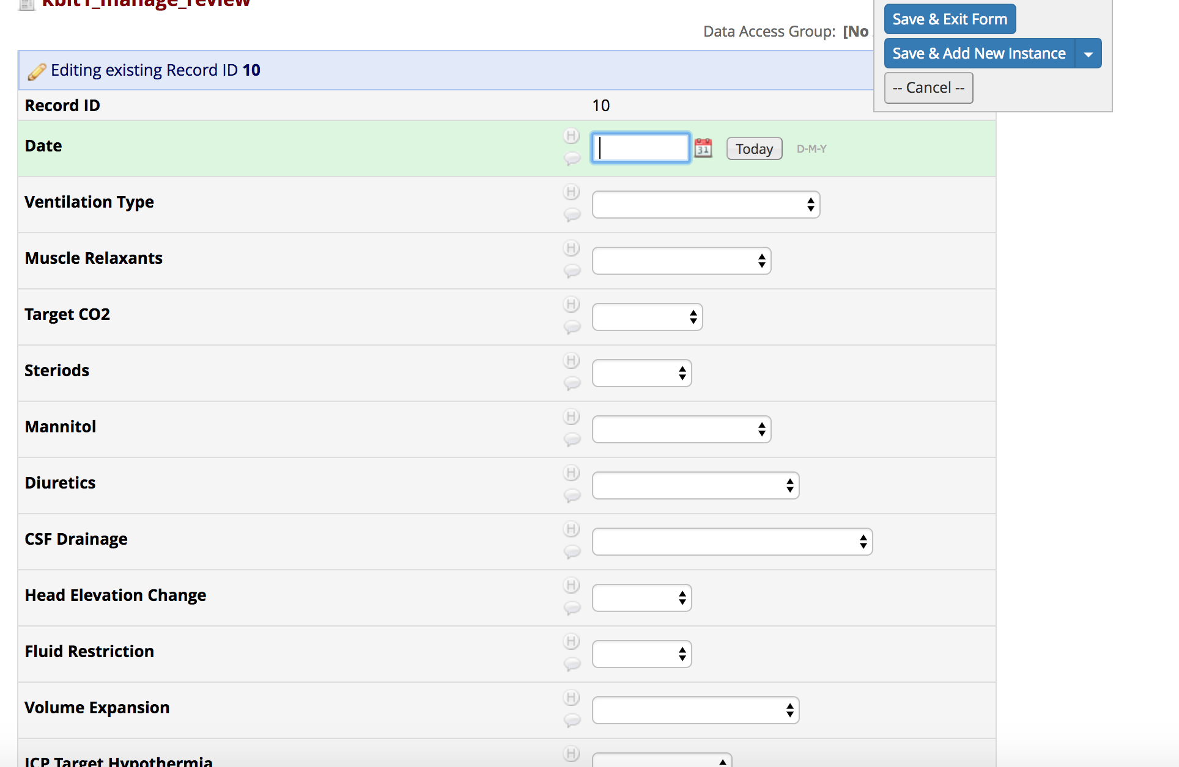
RedCap System

Slide 32
Data Entry - Estimates
Mostly “One-Off Data Fields”
Most time-consuming are:
  Daily Review’s (x Days in ICU)
  Lab Data (Highest & Lowest Per Day Per Result)
All data can be entered “Retrospectively”
If all data sources are available – should not take more than 3-4 hours of data entry…
  Assumes an average 5-6 day PICU stay

Slide 33
Advantages of kidsBrainIT Collaboration?
Access to Grouped Monitoring/Clinical/Outcome Data
  According to BrainIT Access Criteria
Encouraging Local Research
  Medical and Nursing Studies
Generation of Tailored Reports on a Per-Patient Basis Designed by Local Units
  Audit Reports?
  Specialist Reports?

